Slide 1

.

Slide 2
GLOBAL WARMING
Presented by: Muzammal Hussain
Topic: Global Warming (Brief introduction about global warming)

Slide 3
GLOBAL WARMING
Introduction to Global Warming
Causes of Global Warming
Effects of Global Warming
Solutions to Combat Global Warming
Conclusion

Slide 4
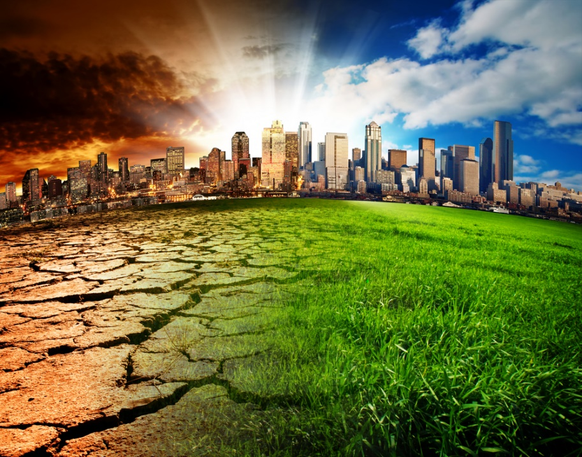
Introduction to Global Warming
Definition: Global warming is the phenomenon where the Earth's surface temperature gradually increases. This rise is primarily caused by human activities that release greenhouse gases into the atmosphere.
Climate Change vs. Global Warming: Global warming refers specifically to the rise in Earth's temperature, while climate change is a broader concept that refers to long-term changes in weather patterns and climatic conditions.
Scientific Evidence: Organizations like NASA and the IPCC (Intergovernmental Panel on Climate Change) have conducted extensive research, showing that the global temperature has increased by about 1.2°C since 1880.

Slide 5
Causes of Global Warming
Greenhouse Gases (GHGs):
Carbon Dioxide (CO2): The largest source of CO2 comes from industrial activities, the burning of fossil fuels (coal, oil, gas), and deforestation.
Methane (CH4): Agriculture (especially livestock), landfills, and fossil fuel extraction contribute to methane emissions. Methane is 25 times more harmful than CO2 in terms of heat-trapping.
Nitrous Oxide (N2O): Emissions from agricultural practices, particularly the use of synthetic fertilizers.
Human Activities:
Fossil Fuels: Transportation (cars, planes), industries, and power plants that burn coal, oil, or gas release greenhouse gases.
Deforestation: Trees absorb carbon dioxide, but when forests are cut down, the absorption of CO2 significantly decreases, contributing to warming.
Agriculture: Livestock farming (especially cows) releases methane, and soil management practices also emit greenhouse gases.

Slide 6
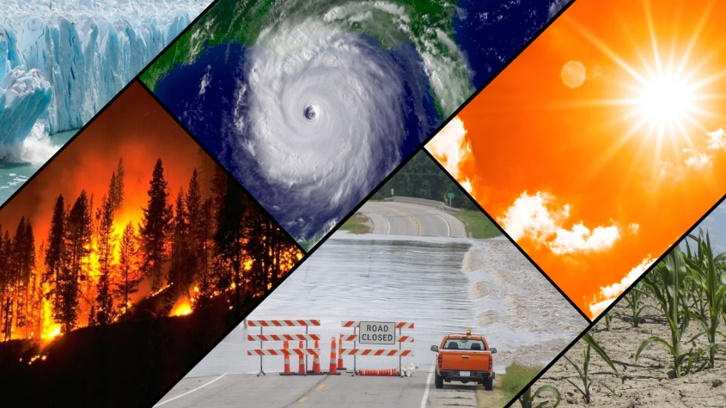
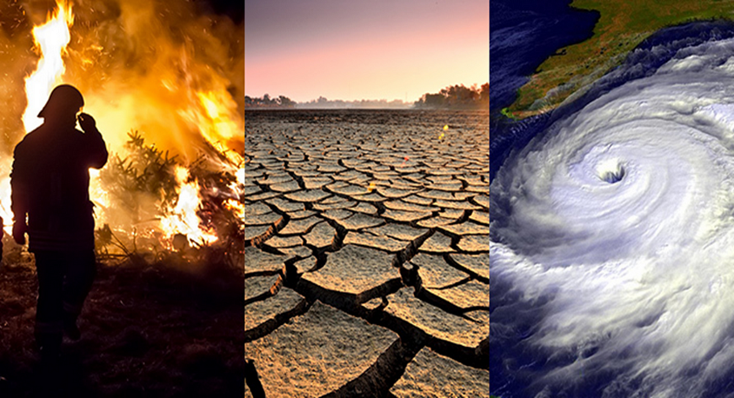
Effects of Global Warming
Temperature Rise: The Earth's average temperature has increased by about 1.2°C from 1880 to the present. This rise is causing more heatwaves and unusual temperature extremes, which are harmful to both humans and nature.
Melting Ice Caps: Polar ice caps (Greenland, Antarctica) and glaciers are melting, which leads to rising sea levels. If the ice continues to melt, coastal cities and islands may face extreme flooding.
Rising Sea Levels: Melting glaciers and thermal expansion (as warm water expands) are causing ocean levels to rise, which is submerging coastal regions.
Biodiversity Loss: Global warming is causing species to lose their natural habitats. Marine life, like coral reefs, is also affected due to rising temperatures and ocean acidification.
Extreme Weather: Higher global temperatures result in more frequent and severe weather events such as hurricanes, floods, droughts, and wildfires.

Slide 7
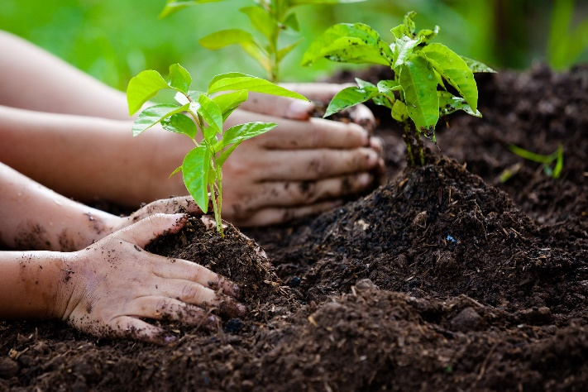
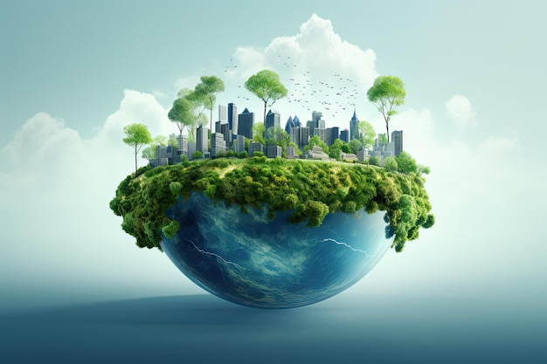
Solutions to Combat Global Warming
Renewable Energy:
Solar: Solar panels convert the sun’s energy into electricity, which is a non-polluting and sustainable source of energy.
Wind: Wind turbines generate electricity, and wind energy is another environmentally friendly source.
Hydropower: Energy is generated from water resources, providing a clean alternative to fossil fuels.
Energy Efficiency: Using energy-efficient technologies in buildings and industries (LED lights, high-efficiency appliances).Promoting public transport and encouraging the use of bicycles and electric vehicles (EVs).
Afforestation and Reforestation: Preventing deforestation and planting trees can help reduce global warming, as trees absorb CO2 from the atmosphere.
International Cooperation: Global efforts like the Paris Agreement aim to limit the rise in global temperatures to below 2°C and pursue efforts to limit it to 1.5°C. Countries are encouraged to set emission reduction targets.

Slide 8

Conclusion
Summary:
Global warming is a serious issue that is caused by human activities, and its consequences are visible globally—rising temperatures, melting ice caps, and extreme weather events.
However, if we adopt renewable energy, protect forests, and implement efficient practices, much can be done to mitigate its effects.
Urgency:
Time is running out. If we don’t act now, future generations will face even more severe consequences.
Call to Action:
Every individual can take small steps in their daily life (such as saving energy, reducing waste).
Governments and corporations should adopt sustainable policies to minimize the future impact of global warming.

Slide 9


Slide 10


